Slide 1
PERSONALISED STUDENT SUPPORT PLANS: EXAMINING THE EFFECTIVENESS OF SUPPORT RECOMMENDATIONS MADE BY STUDENTS
THE CHANGE IN STUDENT ENGAGEMENT WITH PERSONALISED SUPPORT: AN EVALUATION AT THE MID-WAY POINT OF AN ESTEEM-FUNDED PROJECT
DR CATHRYN PEOPLES
c.j.peoples@open.ac.uk

Slide 2
PROJECT AIMS
- To identify how TM354 19J Software Engineering students want to be supported.
- To support students on a one-to-one and group basis in their desired way throughout the 2019J academic year.
- To evaluate the effectiveness of each support approach on a per student basis, measured according to TMA performance, TMA extension requests, and retention on the module, in addition to qualitative findings captured using online surveys.

Slide 3
TUTORIAL OUTLINE
- Overview of personalised support
- Survey perspectives collected from a review carried out in January 2020
- Examination of the factors influencing the achievement of this result
- Reflection on the change in engagement and participation between October 2019 and January 2020
- Conclusions
- Consideration of what’s next

Slide 4
OVERVIEW OF PERSONALISED SUPPORT

Slide 5
WHY PERSONALISED SUPPORT?
- “A sense of ‘belonging’ emerged as a key determinant of student outcomes.”
- “… the strong social need that is a clear element in the face to face experience of education …”
[A. Mountford-Zimdars, D. Sabri, J. Moore, J. Sanders, S. Jones, and L. Higham, “Causes of Differences in Student Outcomes,” HEFCE, Jul. 2015.]
- “… no one has asked students what kind of attention and relationships they want.”
[R. B. Winston and J. A. Sandor, “Developmental Academic Advising: What do Students Want?” NACADA Journal, Apr. 1984, Vol. 4, No. 1, pp. 5-13.]

Slide 6

INITIAL SURVEY DISTRIBUTED TO TM354 STUDENTS
Do you wish to opt in to the Co-designed Student Support project? Yes or No?
The survey was distributed to 38 students across 2 tutor groups (R03 and R08) at the beginning of the module, in October 2019.
Notes:
Survey distributed to 38 TM354 students

Slide 7
REASONS FOR OPTING IN TO RECEIVING PERSONALISED SUPPORT
Student | Reason for Opting In
JC | “I have found the last few modules very challenging to focus on and digest. Specifically M256 and M353 - I struggle with taking in heavy and condensed detail. Also, despite good grades through modules previously, I often let myself down at exams, despite how much effort I feel I put in.”
RS | “Stay motivated and focused”
JF | “I try not to ask for help from my tutors unless I really have to. Maybe a personalised support plan would suit me better.”
AG | “To learn as much as possible from this module and get the best results”
WE | “I am keen to explore how a different approach to support would work and benefit my studies.”
AT | “Struggles with previous modules.”
CH | “Life is hectic.”
AM | “Any help is good, I think you’d be silly not to opt in!”
AW | “Curious to see what might be different”
BG | “I think it would be stupid not to. It has proved helpful and I am grateful of the extra support.”

Slide 8
CHARACTERISTICS OF STUDENTS WHO ENGAGED WITH RECEIVING PERSONALISED SUPPORT
Student | DoB | Special Characteristics | Prior Performance
JC | 1981 | - | Medium
RS | 1976 | - | Medium
JF | 1974 | - | High
AG | 1983 | - | Medium
WE | 1988 | - | High
AT | 1986 | - | Medium
CH | 1996 | CMT Type 1A, Scoliosis, Scheuermann's Disease Under 25 | -
AM | 1997 | Under 25 | High
AW | 1993 | - | High
BG | 1990 | - | Medium

Slide 9
HOW HAVE STUDENTS ENGAGED WITH PERSONALISED SUPPORT?
Student | Support ID (requested) | Support ID (in practice)
JC | 1, 2, 3, 4, 5 | 1, 2, 3, 4, 5
RS | 2, 3, 4, 5 | 4~
JF | 4, 5 | 4, 5
AG | 1, 2, 3, 4, 5 | 4
WE | 1, 2 | 1, 2
AT | 1, 2, 3, 4, 5 | 1~
CH | 1, 2, 3, 4, 5 | -
AM | 1, 2, 3, 4, 5 | 2
AW | 2 | -
BG | 1, 2, 4 | 2
SUPPORT ID | SUPPORT APPROACH
1 | Personal Development Plan (PDP)
2 | Skype/Slack on an ad hoc basis
3 | Scheduled interactions
4 | Group chat in Slack
5 | Diary

Slide 10
INITIAL FINDINGS
The students who initially engaged do not have the most to gain – they are part of the higher-performing cohort.
  Why might they have engaged?
    More committed to their study in general?
    Willing to devote more time to something they may benefit from?
Students who may have more to gain have not taken advantage of the opportunity.
  Why might they have not engaged?
    Lack of confidence in engaging on a more direct one-to-one basis?
    Are they lower performing students because they have limited time for study and study-related aspects in general?

Slide 11
WHO DIDN’T ENGAGE FROM THE BEGINNING, AND WHY?
JG | “I opted out as it felt that it may require more organisational time to dedicate to the course. As my study time is limited and more than a little random I felt that having a more organised support structure would only infuriate the tutor! As I write this though, it maybe that more structure is what I need to get more from the course...”
SD | “In all honesty, it sounds quite good. I just have to manage my time so meticulously to ensure I have time for everything. I don't want to risk participating when I'm unsure of the amount of input that would be required.”
Student | DoB | Special Characteristics | Prior Performance
JG | 1981 | ~ | Medium
SD | 1976 | ~ | Medium
Asperger’s
Autism
Notes:
SD became involved later, in February 2020
1 student from R03
1 student from R08
Neither of these students have registered disability, but they both disclosed to be at later points in the module that each of them has a disability

Slide 12
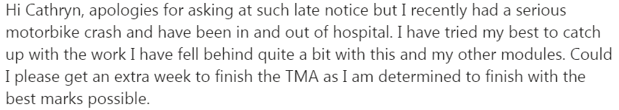
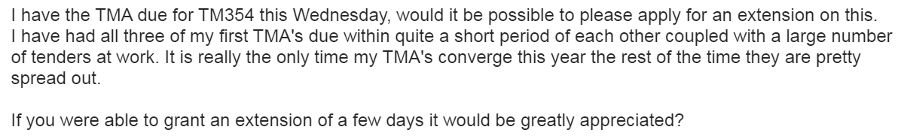
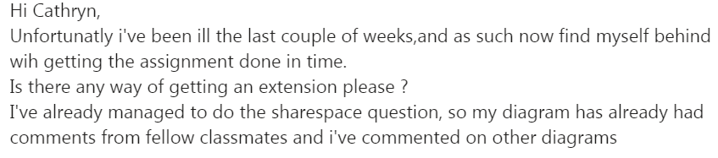
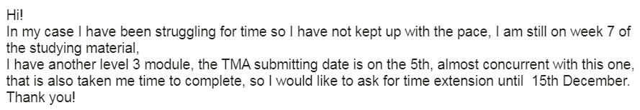
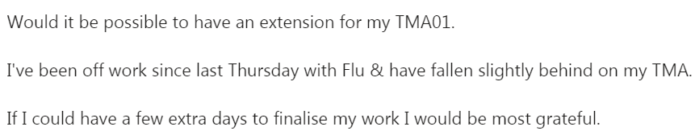
EXTENSIONS FOR TMA 01
- 10 students out of a group of 38.
- 2 of these students were receiving additional support; both students have registered disabilities.

Slide 13
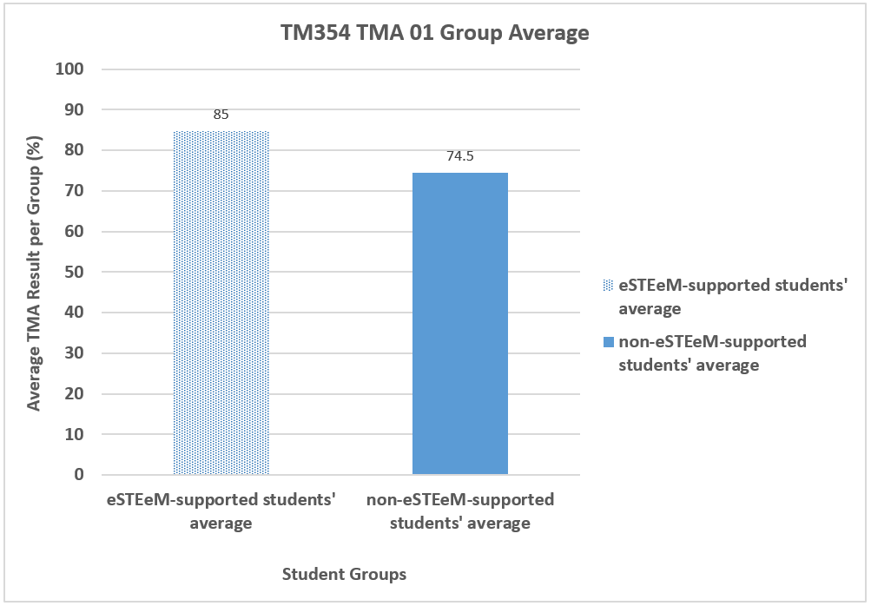
TMA 01 PERFORMANCE

Slide 14
JANUARY 2020 REVIEW

Slide 15
JANUARY 2020 REVIEW
All students were surveyed in January 2020. 7 students out of 38 responded.
Student | How Comfortable do you feel with TM354?
JC | “Fairly – it’s a very challenging and detailed area of study.”
RS | -
JF | “About 6 out of 10. I find I’m having to reread sections more than once to understand it.”
AG | “Fairly comfortable but certain parts are harder to digest and there is a lot of stuff to remember.”
WE | “Not overly, this module is a lot more intense compared with previous, specifically in terms of reading heavy. I feel I am starting to understand key concepts, however, there is a vast amount to try and recall.”
AT | “not comfortable at all”
CH | -
AM | -
AW | -
BG | “Reasonably comfortable. A lot of new things to take in, but with the help of Cathryn and her Slack channel, I know any question I have will be answered very quickly and it helps massively.”

Slide 16
CHANGE IN ENGAGEMENT
1 student responded who was not a participant of the programme:
Qu: How comfortable do you feel with TM354?
Ans: Everything is new to me, I struggle to grasp some of the learning material. Lots of information to cover.
Qu: With hindsight, would you have managed the first half of the module differently? How?
Ans: Spend more time with the current learning and if I had some little brief knowledge of the concepts being taught.
Qu: Would you like the opportunity to explore the personalised support? Why?
Ans: Yes, but I wonder if it would be different.
Notes:
I invited this student to participate in the programme but he did not engage at all.

Slide 17
CHANGE IN ENGAGEMENT
1 student responded to the January 2020 review who initially signed up to the programme, but informally (in the sense that he didn’t communicate it with me) ceased to engage.
Qu: How comfortable do you feel with TM354?
Ans: Not comfortable at all
Qu: In what way is the personalised support beneficial to your TM354 experience?
Ans: Received good feedback and suggestions in the beginning.
Qu: Are you happy to continue with the personalised support?
Ans: No
Qu: Do you wish to adapt your support in any way?
Ans: I am not able to remain consistent with my initial plan and see no point in continuing receiving personalised support as there is not much my tutor can do to help right now.
Notes:
AT

Slide 18
CHANGE IN ENGAGEMENT
I have had another student sign up for the programme in February 2020:
“Always the obvious answer but I can't handle not knowing. A trait of being on the spectrum”
I invited him to join in after receiving the following email:
“I was wondering about the possibility of an extension. I've got three TMAs within very close proximity of one another and I'm struggling to keep on top of the actual module work while committing enough time to them.
I think there's a possibility I'll get the TMA submitted by the deadline but I'm losing sleep over the possibility of not doing so. I've got something for every answer but it's far from complete or at a standard I'd be happy with submitting.
I work 50 hour weeks and I'm studying at full intensity. I'm managing my time as best I can but I'd hate to sacrifice more marks than necessary. I've never had an extension in my years of study with OU, and never failed to submit an assignment on time, so this request is a little embarrassing for me.”
Notes:
“being on the spectrum” – this student does not have a registered disability with the OU

Slide 19
STUDENTS’ FEELINGS ABOUT THE PROGRAMME
Student | In what way is the personalised support beneficial to your TM354 experience?
JC | “It helps to add an element of coaching and discussion to help understanding topics.”
RS | -
JF | “The support I have received to date has been the best experience of any module I have studied. I particularly find the short weekly tutorials beneficial and the contact I have with you feels much more personal than it has been in previous modules.”
AG | “It is extremely beneficial as it makes me think more about the module material and it also keeps me motivated.”
WE | “Good contact and support with yourself (the tutor) knowing I have someone to talk issue through with. This stops the ‘boiling pot effect’ getting working up over minor problems.”
AT | “Received good feedback and suggestions in the beginning”
CH | -
AM | -
AW | -
BG | “As above – it has been fantastic, quick responses in Slack have been much appreciated.”

Slide 20
TMA 02 EXTENSIONS
Out of 38, 13 students extended their TMA 02 submission.
In terms of students requesting extensions who were receiving additional support:
- 2 of these students had signed up for support but did not engage in practice.
- 1 student was an active participant but had personal challenges around December 2019.
Notes:
The majority of students who were extending were not active participants in the project.

Slide 21
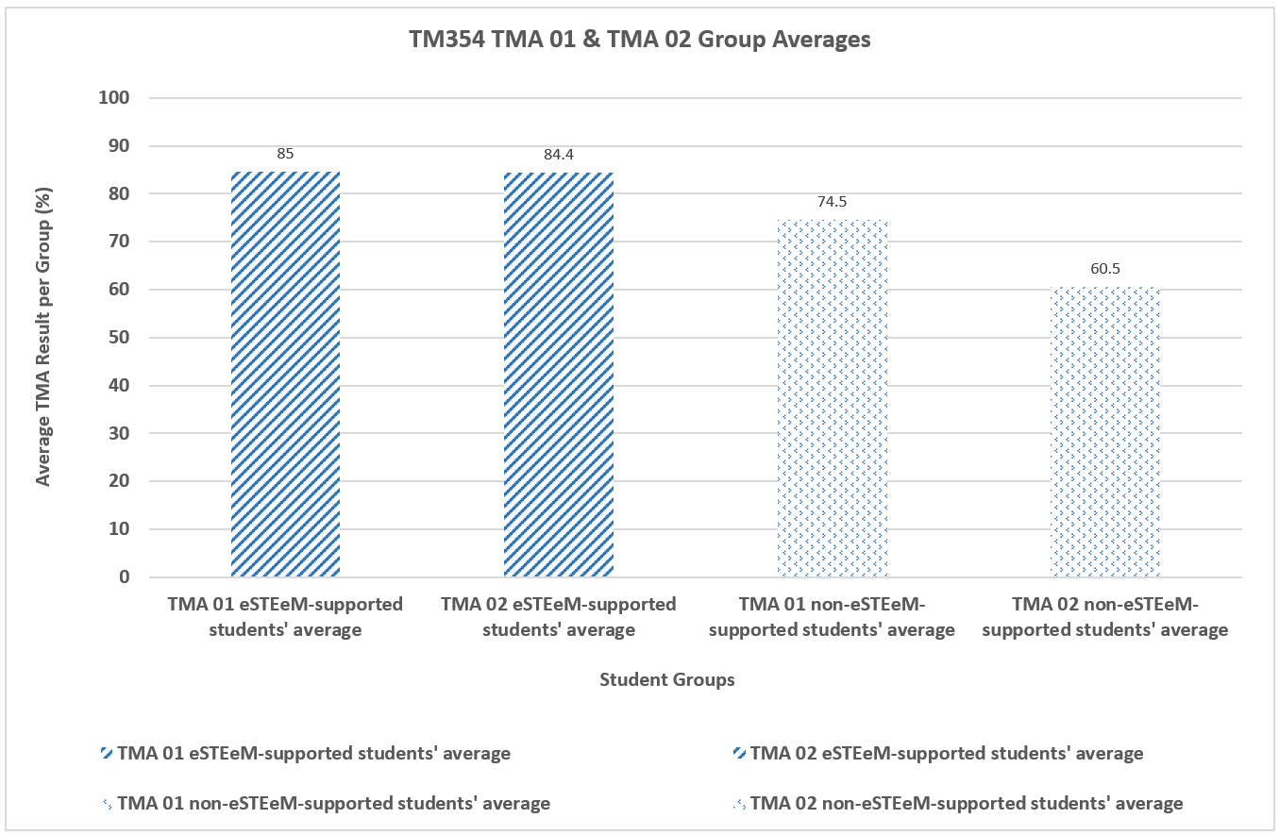
TMA 02 PERFORMANCE

Slide 22
HOW HAS THIS POSITIVE RESULT BEEN ACHIEVED THROUGH PERSONALISED SUPPORT?

Slide 23
GROUP CHAT IN SLACK
JC I think I am ok with the TMA but still waiting to progress onto Qs 4 and 5...
9:06 PM had a quick read through again earlier
9:06 PM JF My mind is fried today. I've had most of the day of work to catch up so I need to go over the TMA again to see what I'm not sure about
9:07 PM Cathryn okay, no problem at all
9:07 PM JF I've actually answered all the questions, but when I read over them earlier they weren't great answers! It's a start though
9:07 PM JC I think I will be struggling a bit with preparing the detail in use cases when i get to it
9:08 PM Cathryn yes, it's a good approach to go back and edit your answers, JF
9:09 PM the use cases are Qu 4b, and 4c - is that what you are referring to JC?
9:10 PM JC yes - thats the ones, I found most of unit 3 pretty hard going!
9:10 PM JF Same here. There has been a lot to take in.
9:11 PM JC I must admit, I skimmed through parts due to time constraints
9:11 PM Plus I found things just weren’t sinking in, so read onto other parts
9:12 PM JF I went back to unit 1 today and had a skim over it because I don't think I understood any of it. It is all starting to make a bit of sense now I've read further into the materials.
9:13 PM JC I think that's a good approach to take - I think I have forgotten a lot of the aspects in unit 1...!
9:13 PM Cathryn that's interesting, that you are both feeling the same way about the material at the same time
9:13 PM JF I looked at my notes but they made no sense as I didn't know what I was trying to say back then.
9:15 PM JC I think we may have hit critical mass prior to the tma... I tend to take basic notes, thinned down text from the books and reference the page numbers to get more detail. More like prompts to read up. I tend to only do that when writing up the tma's though
Notes:
TM354 specific discussion
Evidence that the students are very sympathetic with one another

Slide 24
GROUP CHAT IN SLACK
9:16 PM JC that is exactly what I am hoping for - plus a bit of time during christmas
9:17 PM Good thing at least is that I am sticking with the planner to keep me from slipping back
9:17 PM Cathryn yes, and now we've found those missing sections!
9:18 PM JF I need to keep getting ahead as I know I have some busy periods coming up where I will lose time!
9:18 PM JC oh god yes - tha t totally threw me! Did you notice that @JF regarding the jumbled up units last week and missing sections..?
9:18 PM Cathryn it's great John that you can self-manage like that
9:18 PM JF No. I was just about to ask what you were talking about?!
9:19 PM JC Yep, My work is very sporadic so have to take advantage where I can....
Notes:
Nice authentic real chat here

Slide 25
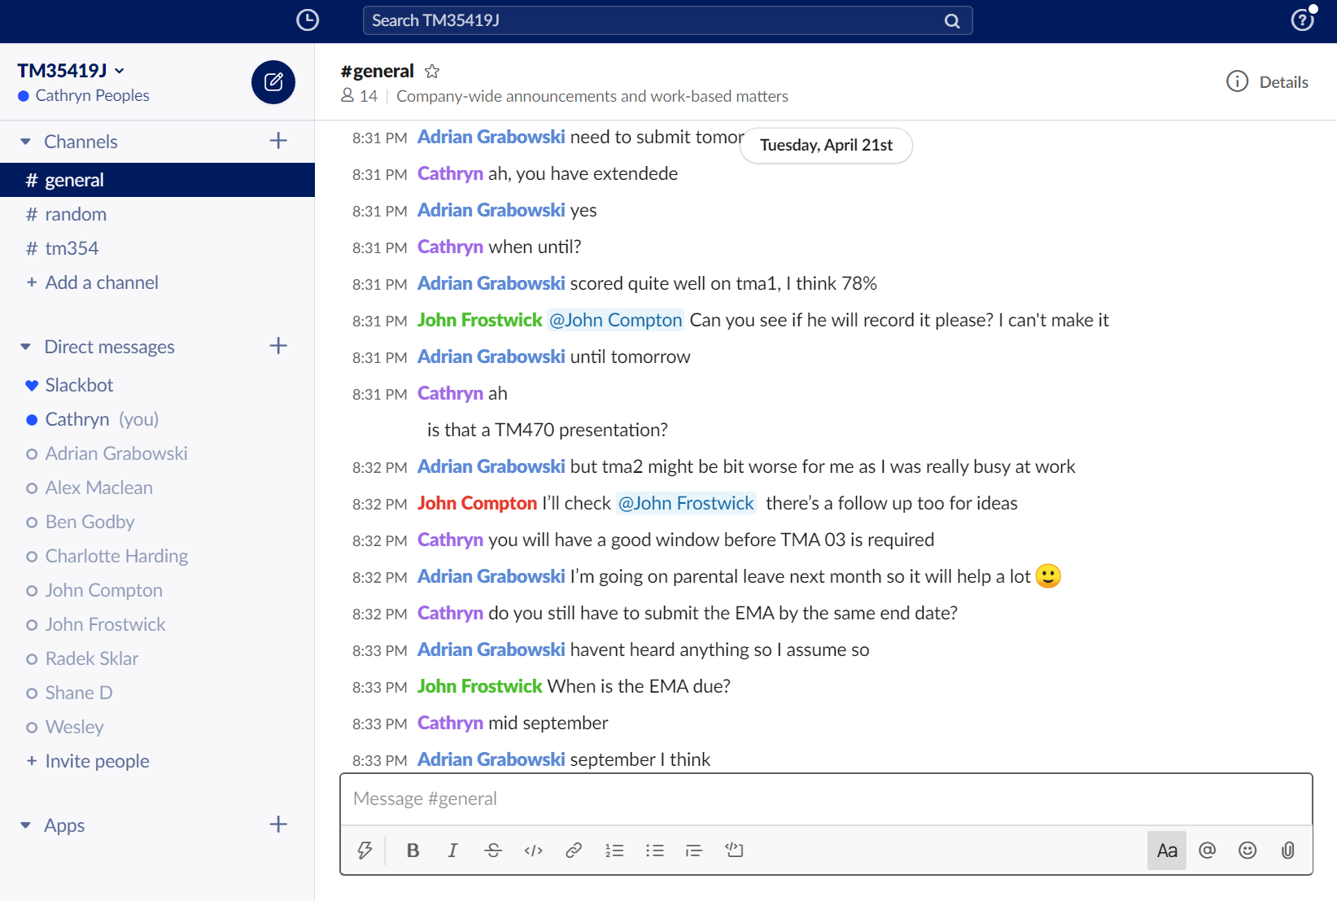
GROUP CHAT IN SLACK
Notes:
And also non TM354 specific discussion
Some of the students are also studying TM470, and we also talk about these other modules. While me and one student are talking about one thing (blue box), you can see that two other students are actually talking about something else, which is also related to the module.
Red box – one student is actually asking the other student to ask the tutor of an online session to do something for him

Slide 26
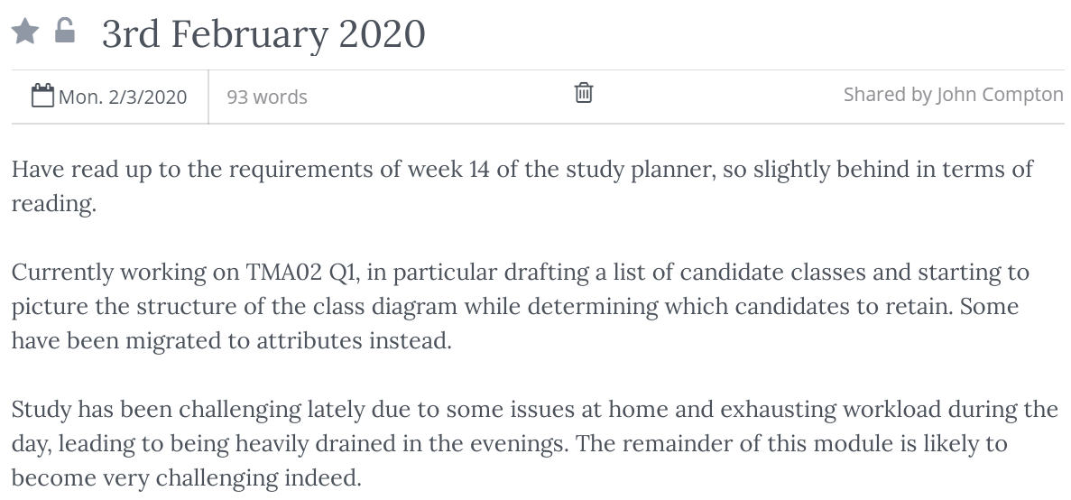
DIARY ENTRY

Slide 27
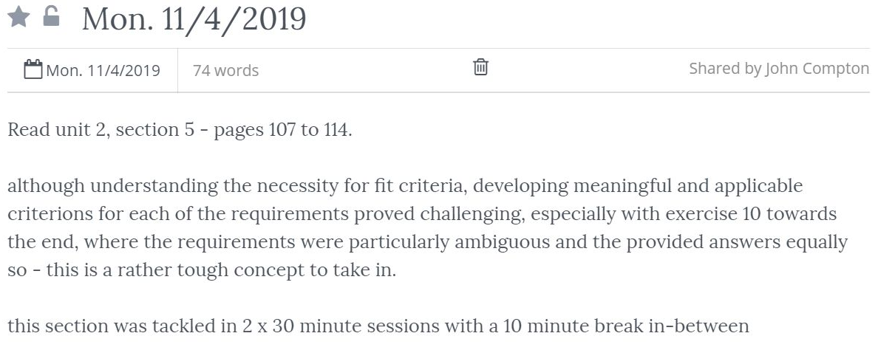
DIARY ENTRY

Slide 28
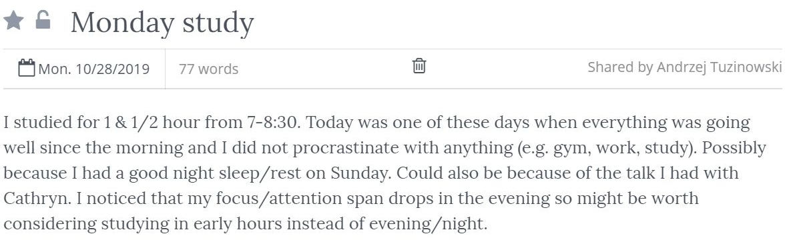
DIARY ENTRY

Slide 29
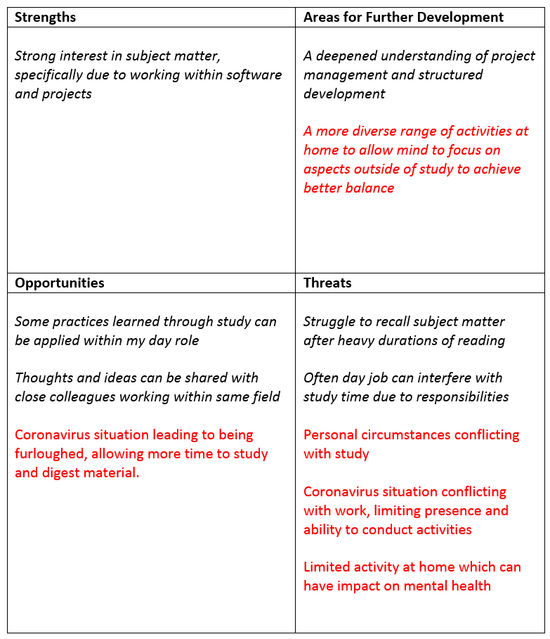
PERSONAL DEVELOPMENT PLAN

Slide 30
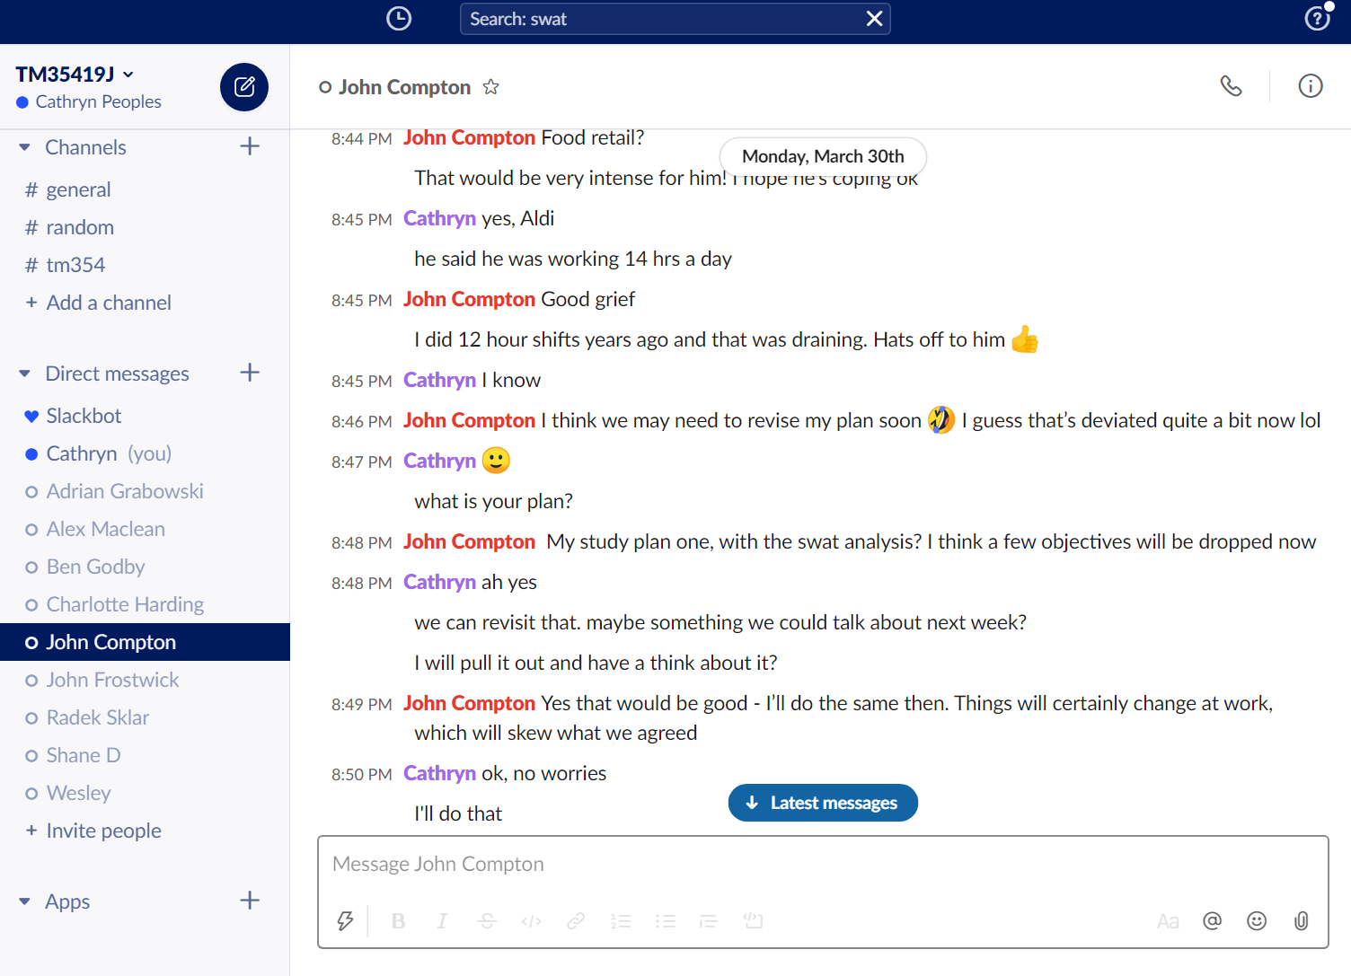
AD HOC CHAT IN SLACK

Slide 31
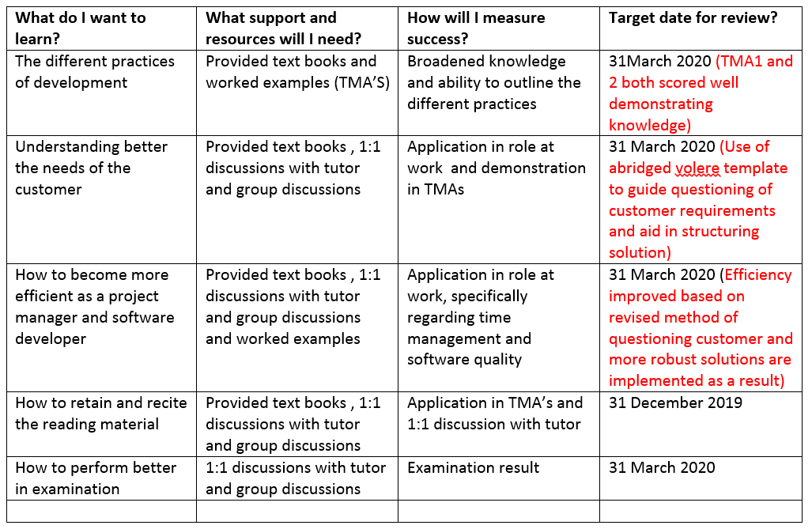
PERSONAL DEVELOPMENT PLAN

Slide 32
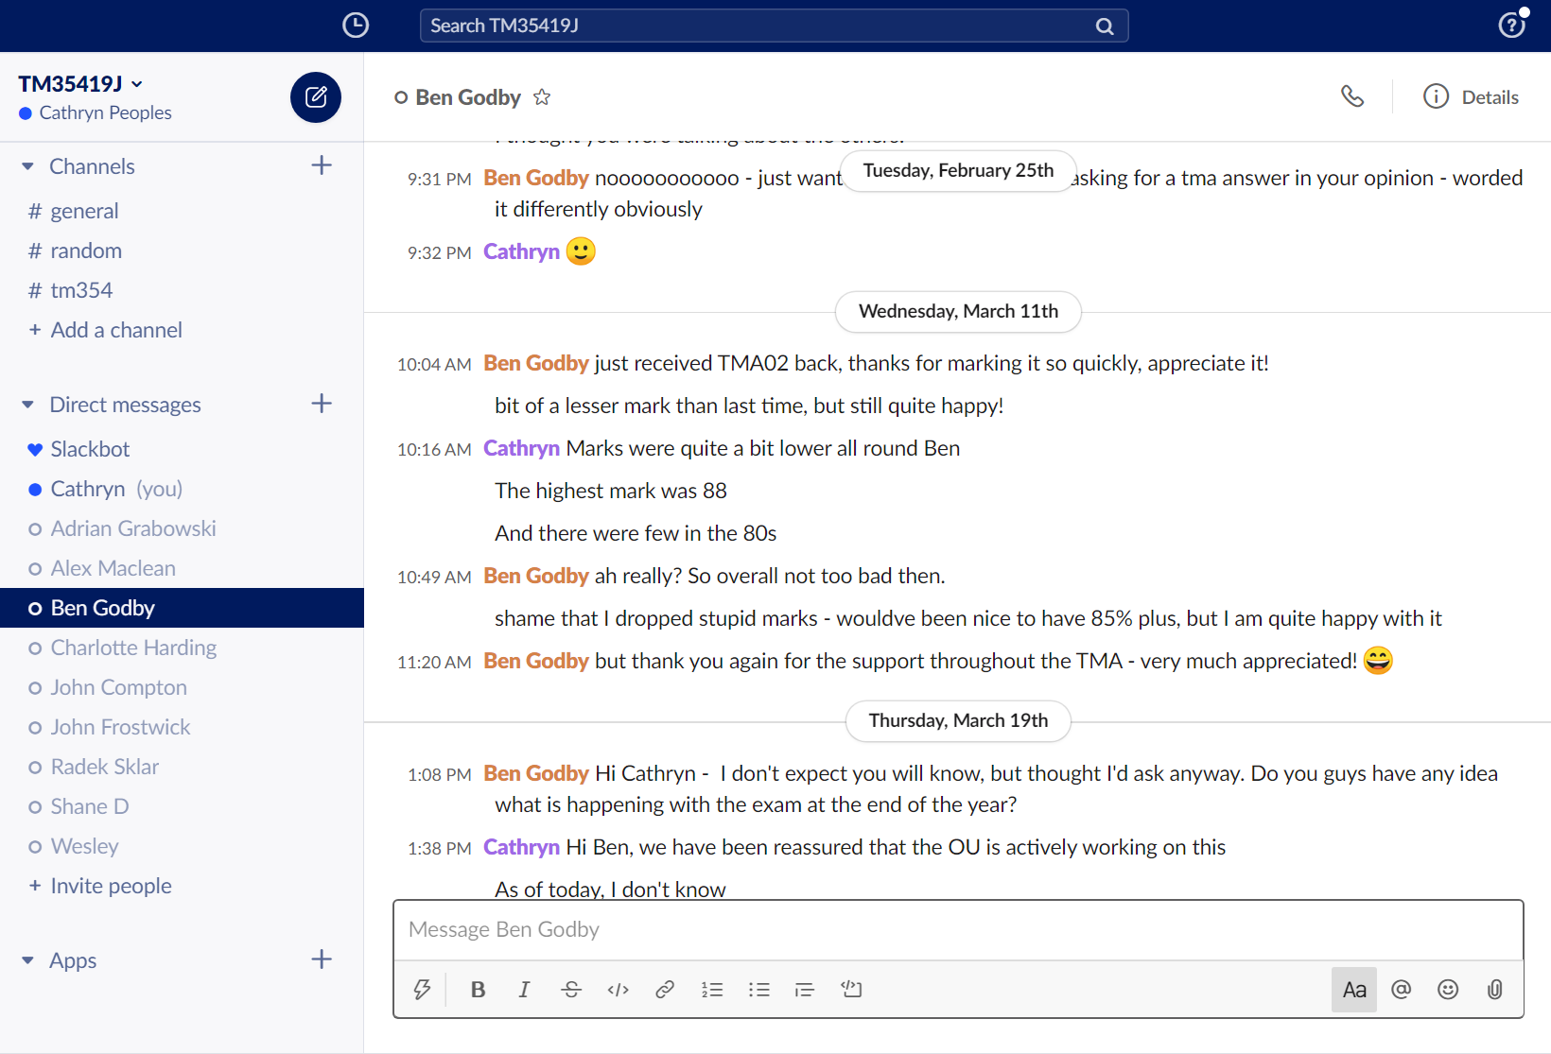
AD HOC CHAT IN SLACK

Slide 33
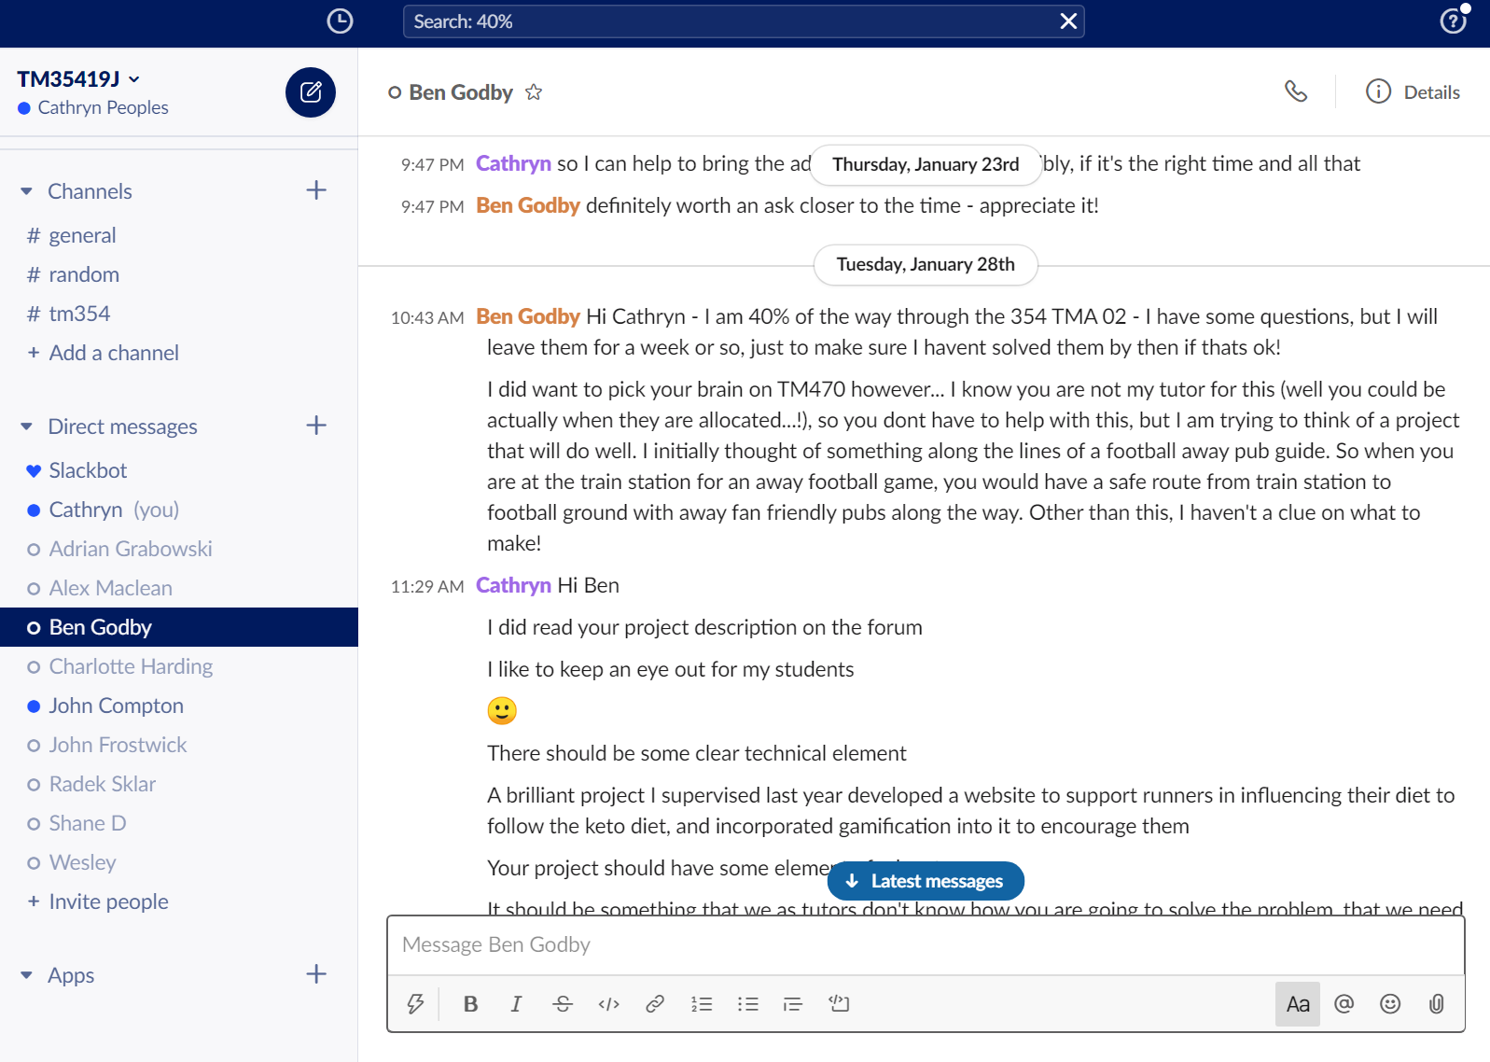
AD HOC CHAT IN SLACK - PROVIDING BROADER SUPPORT THAN TM354

Slide 34
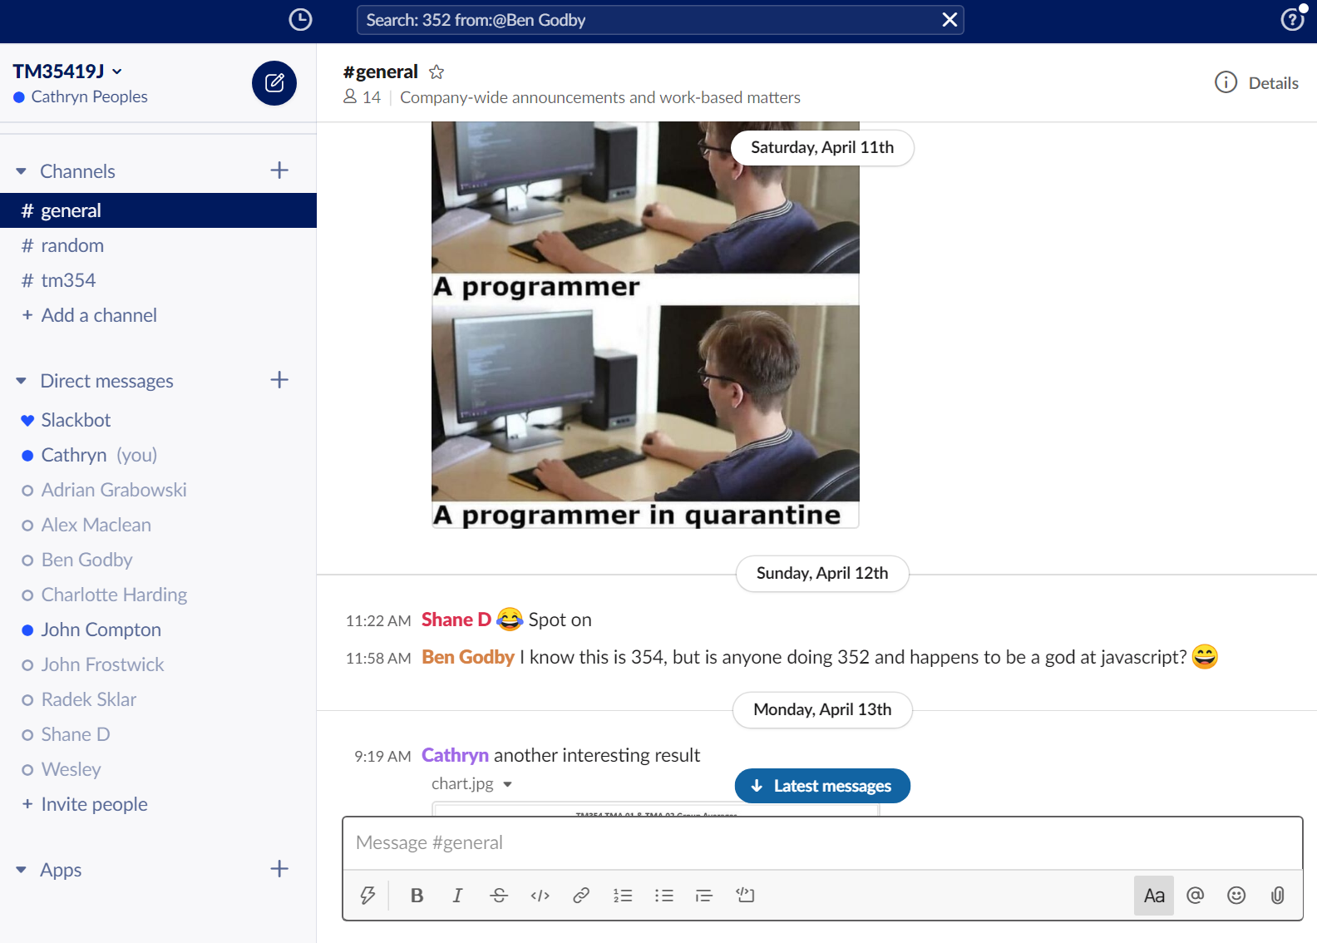
STUDENT REACHING OUT TO OTHERS IN SLACK

Slide 35
CHANGE IN ENGAGEMENT & PARTICIPATION BETWEEN OCTOBER ’19 AND JANUARY ‘20

Slide 36
REASONS WHY PARTICIPATION IN PROGRAMME MAY HAVE CHANGED
Student | Have any unexpected events affected your ability to study for TM354?
JC | “I have a very unpredictable workload with my day job, that can affect my own study planning”
RS | -
JF | “Yes. I lost my broadband connection for two weeks which only provide to be an inconvenience and didn’t affect my ability to study too much. I also had a bit of a medical issue which is all sorted now, but I was way ahead anyway so didn’t affect things too much.”
AG | “Not unexpected by a lot of changes going on in my life at the moment which sometimes make it hard to find time to study.”
WE | “No truly unexpected life events to report”
AT | “Having to take on additional duties at work which in effect increased my stress levels and affected my health”
CH | -
AM | -
AW | -
BG | “Not really, I am now jobless which is great, but also means I will be homeless very soon. Not causing much of a problem yet, but may do in the upcoming months.”

Slide 37
DID STUDENTS WISH TO ADAPT ANY PART OF THEIR SUPPORT BY JANUARY 2020?
Student | Do you wish to adapt your support in any way?
JC | “Maybe to have an agenda ahead of chat sessions, to help to prepare for more detailed discussions on subject material.”
RS | -
JF | “No. I find the support I’m currently receiving is perfect right now.”
AG | “Nothing comes to mind, it was very helpful so far.”
WE | “No, all good from a tutor-student perspective. However, I wish there was more student-student interaction within the chatrooms. Though this is based on personalities.”
AT | “I am not able to remain consistent with my initial plan and see no point in continuing receiving personalized support as there is not much my tutor can do to help right now.”
CH | -
AM | -
AW | -
BG | “I really cannot think of something. Perhaps bi-weekly tutorials that consist of asking any questions (over mic and with other students) may be helpful, but I don’t think it is necessary. Keep up the good work!”

Slide 38
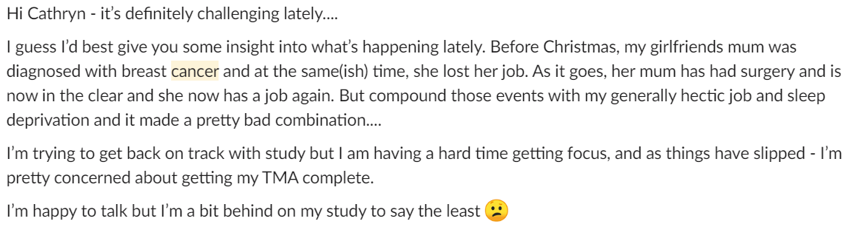
GENERAL OBSERVED CHANGE IN ENGAGEMENT
- Student diaries have become less frequent.
- One regular student dropped away from the weekly group chat.

Slide 39
GENERAL OBSERVED CHANGE IN ENGAGEMENT
General change in participation in the group chats:
“Hi Cathryn, I’m sorry I couldn’t make it last Tuesday but again I finished quite late at night, hopefully it will be less busy this week. I’m trying to catch up with the studies now as I got bit behind, we are getting ready to adopt a child and it involves quite a lot of training and doing meeting with our social worker. It’s going to be quite a busy year for us as I also want to apply for a British citizenship this summer, that involves bit of studying as well :slightly_smiling_face:”
Notes:
Participation in the group chat did change. A couple of weeks no one attended, a couple of weeks there was only 1 student in attendance.

Slide 40
CONCLUSIONS

Slide 41
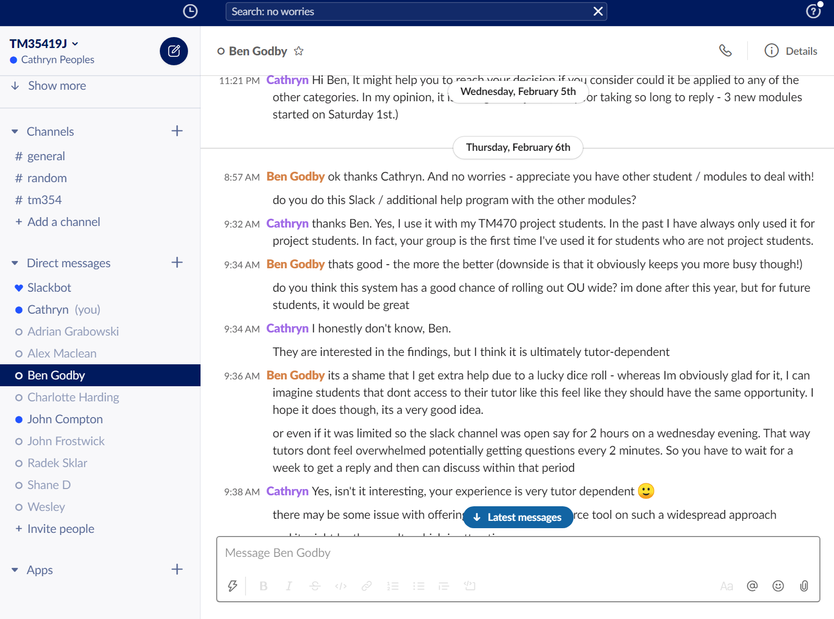
WHAT A STUDENT HAS TOLD ME ABOUT THE PROGRAMME’S QUALITIES AT THE MID-POINT

Slide 42
CONCLUSIONS
Students are perhaps not as keen to participate in increased engagement as the literature suggests.
However, it is significant that by the end of April 2020, no students have deferred the module.
It may therefore be the case that just knowing the support is there is enough to improve retention.
Students participating in the personalised support are performing more highly than those who are not.
The number of extension requests is high from students not participating in the personalised support.

Slide 43
CONCLUSIONS
Some students explained their lack of participation as being due to a concern about being a nuisance for me:
- Unable to be consistent in their engagement
- Wanting to change/adapt their degree of engagement
The increased rate of engagement is not natural for the students. One student sets an alarm on his phone to remind him of the group chat, and two tell me that they keep forgetting to write their diaries.
Students did not make any recommendations of ways they wanted to be supported and were happy to take my suggestions.
As a result of making myself more available to students, I identified that there were disabilities across the group which were not revealed through the student record.

Slide 44
WHAT’S NEXT?
Notes:
I would like to examine the reasons why the students who could perhaps benefit more from an increased level of support are not participating in such programmes, by examining ….

Slide 45
IS IT THEM? IS IT ME?
What makes a tutor approachable?
“Having the reassurance that it's ok to contact them makes a difference. Personally I always try to struggle through something before I reach out for help as I appreciate people are very busy, and I'm aware that my struggles to understand something might not be as important to others. That's a personal thing though, I've never been given that opinion by any tutor I've ever had.”
“A friendly demeanor. Perhaps a little involvement on the forums. Reaching out initially is always nice too.”
“Someone who is patient if I don't understand the problem after their first response. Also responses that do not come across as rushed help.”
“Openness, being able to ask even the most basic or what might seem like a stupid question without being judged. I understand this can be frustrating, but everyone learns differently. If the individual still doesn't understand, being able to explain it again using a different method can help and shows a tutor has a deep level of understand of the subject.”
“Honesty. Understanding the problems that student is facing.”
“It is also crucial that they act as an ambassador for the institution that they are working for”
“Finding something to connect with.”
Notes:
Is it them or is it me?
Students had a lot of opinions on what makes a tutor approachable

Slide 46
IS IT THEM? IS IT ME?
What makes a tutor approachable?
“Being communicative and confirming availability and unavailability, especially around TMAs and in the lead up to exams.”
“I guess this can only come down to communication, and the tutor "stepping away from their office into the lives of the students". Somehow the remote study distance between the student and the tutor needs to be bridged, and the tutor is the experienced one so should probably be the one to instigate the interactions until the student feels comfortable with asking first.”
“It comes down to attitude. I find tutors approachable if: - they give clear tutorials - offer help in tutorials, via e-mail etc. and remind students they are available to do that - they don’t intimidate students - they are able to be flexible to student needs e.g. if they realise in a tutorial we’re all struggling with a concept dedicating time to getting us all on the same page - they offer some form of interaction in tutorials. If they just talk at us, don’t answer questions etc they don’t seem approachable”
“Having met a tutor in person at a tutorial can be helpful, putting a name to a face. Also an email introducing themselves with a little bit of background about who they are.”
Notes:
From 18j survey

Slide 47
IS IT THEM? IS IT ME?
What makes a tutor approachable?
“Clearly showing that they put the students first, that they respect them, appreciate them, understand them and give value to them. Sufficiently expressing that students can be at ease around them, such that the students know they won’t be made to feel inadequate, dismissed, or humiliated. Students need to know straight away from the very first impression, that their Tutor will always say and show to them ‘you can do it.’ They don’t want a tutor who forever brags ‘I (the tutor) can do it’ or who says ‘you can’t or shouldn’t do it’. The student is saying enough of ‘I can’t or shouldn’t do it’ to themselves. The last thing they need is a tutor adding to that ‘I can’t’. They need a tutor who turns the students own I can’t’s into I can’s. Demonstrating this is what makes a tutor approachable. If someone’s confidence is boosted with encouragement and enough ‘you can’s’, they start to believe they can, and they do it. Equally, if they’re made to feel inadequate with enough you can’t’s, they start to believe they can’t, and so they quit.”

Slide 48
IS IT THEM? IS IT ME?
What makes a tutor approachable?
“Unfortunately, on rare occasions, I’ve seen students who have been made to feel humiliated and inadequate at the hands of a small minority of OU tutors. Each occasion they’ve all been Tutors of the following characteristics. Aloof, arrogant, repeatedly bragging about and showing off how academically brilliant they are, how wonderful and difficult their PhD was etc., and judging students against their own brilliant academic standards. They quickly show they’re not that interested in the students and only students who are obvious fellow academic high fliers get a worthwhile consideration from them. Those students that don’t understand what is being explained to them quickly enough are shown disinterest and even curtly dismissed. It’s clear they really know their stuff, but they are unwilling and unable to place adequate interest in the student and explain and import that knowledge and confidence into the student. Often because they’re too aloof and in love with themselves to put themselves in the shoes of students learning the subject for the very first time. For example, a student tutor exchange I witnessed at a recent day school for M269. Student: said in a deflated tone. “I’m finding this subject really hard.” Tutor: said curtly, contemptuously and dismissingly. “Oh it’s not, it’s easy, it’s easy.” That was literally his response. Then, later on, the same Tutor: “It really annoys me when students say they don’t understand the maths and ask me to explain it in English.” To me, maths is English, it doesn’t need explaining.” Another example, I once saw a few OU students publicly quit a module because of one too many critical forum posts from their own aloof and arrogant tutor, who was also the main author of the module. Basically, many students were struggling and panicking asking for help on the forums, and he made several posts dismissing all those students and telling them to stop asking for help.”

Slide 49
THANK YOU

